Slide 1
JAVA PROGRAMMING LANGUAGE UNIT -V
M.PRAKASH
ASST.PROF IN COMPUTER SCIENCE

Slide 2
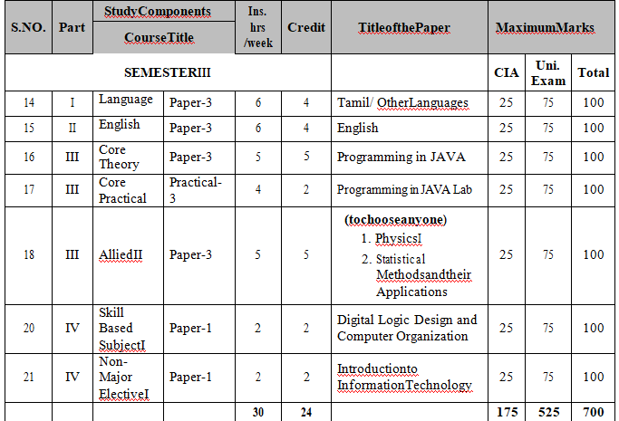

Slide 3
UNIT-V SYLLABUS
Applets: Applet fundamentals - Applet class - Applet life cycle - Steps for developing an applet program - Passing values through parameters - Graphics in an applet - Event-handling. GUI Applications - Part 1: Graphical user interface - Creating windows - Dialog boxes - Layout managers - AWT component classes - Swing component classes. GUI Applications - Part 2: Event handling - Other AWT components - AWT graphics classes - Other swing controls.

Slide 4
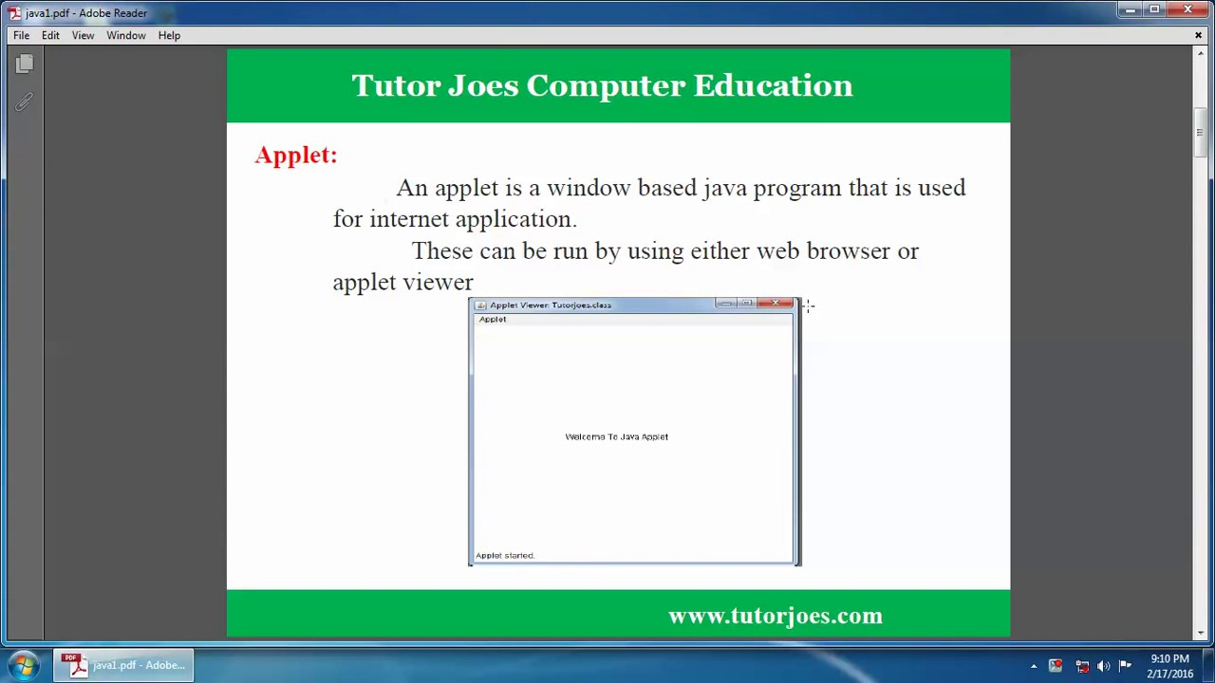
Applet is a special type of program that is embedded in the webpage to generate the dynamic content.
It runs inside the browser and works at client side

Slide 5
Applets
Types of applets
A web page can contain two types of applets:
Local applet
Remote applet
Local applets
Local applets are developed and stored locally, and therefore do not require an Internet connection to be located because the directory is located on the local system.

Slide 6
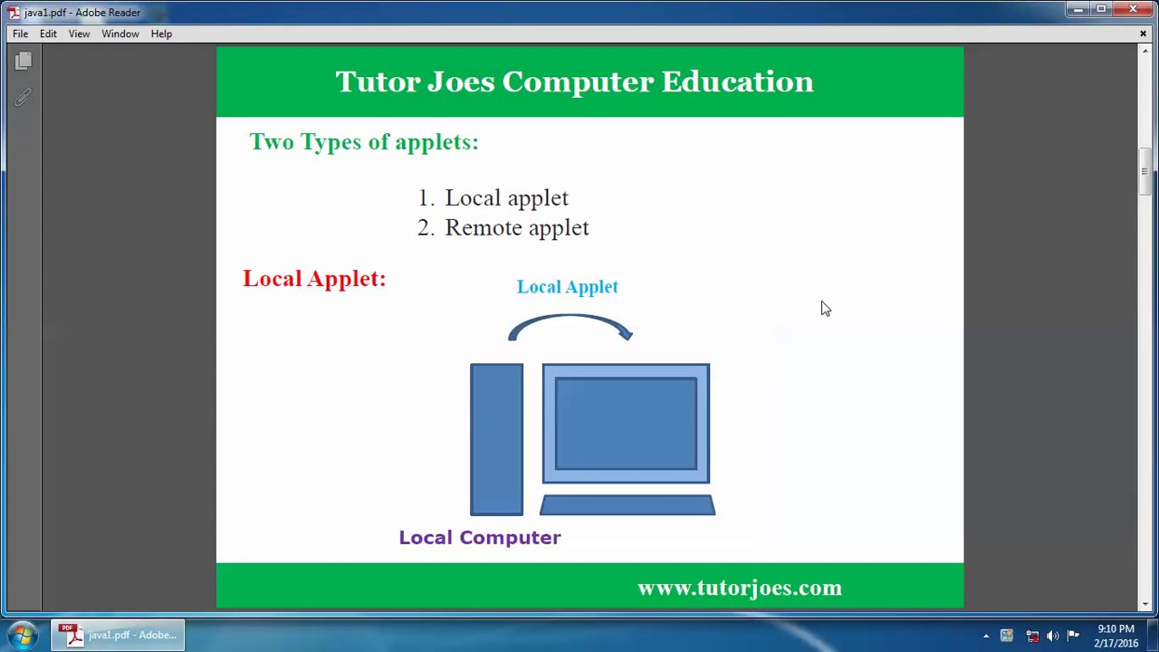

Slide 7
Applets
Remote applets
Remote applets are stored in a remote computer and an Internet connection is needed to access them. The remote applet is designed and developed by other developers. To find and load a remote applet, you need to know the address of the network applet, i.e., the Uniform Resource Locator (URL).

Slide 8
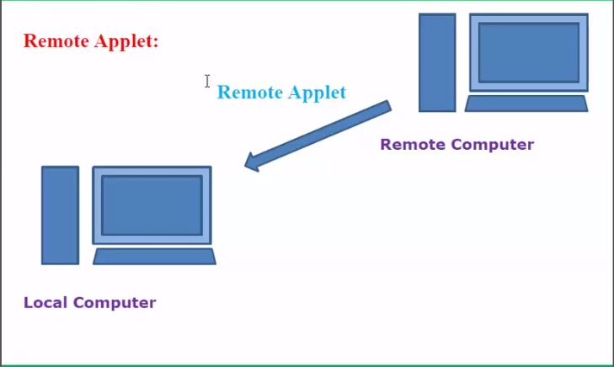
Applets

Slide 9
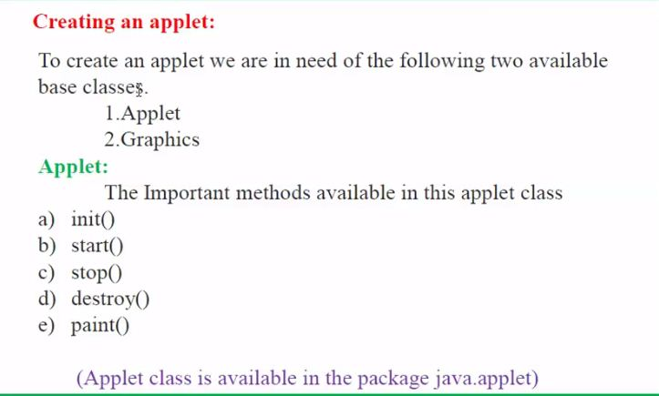
Applets

Slide 10
java.applet.Applet class
For creating any applet java.applet.Applet class must be inherited. It provides 4 life cycle methods of applet.
public void init(): is used to initialized the Applet. It is invoked only once.
public void start(): is invoked after the init() method or browser is maximized. It is used to start the Applet.
public void stop(): is used to stop the Applet. It is invoked when Applet is stop or browser is minimized.
public void destroy(): is used to destroy the Applet. It is invoked only once.

Slide 11
Methods Applet
init(): The init() method is the first method to run that initializes the applet. It can be invoked only once at the time of initialization. The web browser creates the initialized objects, i.e., the web browser (after checking the security settings) runs the init() method within the applet.
start(): The start() method contains the actual code of the applet and starts the applet. It is invoked immediately after the init() method is invoked. Every time the browser is loaded or refreshed, the start() method is invoked. It is also invoked whenever the applet is maximized, restored, or moving from one tab to another in the browser. It is in an inactive state until the init() method is invoked.

Slide 12
Methods Applet
stop(): The stop() method stops the execution of the applet. The stop () method is invoked whenever the applet is stopped, minimized, or moving from one tab to another in the browser, the stop() method is invoked. When we go back to that page, the start() method is invoked again.
destroy(): The destroy() method destroys the applet after its work is done. It is invoked when the applet window is closed or when the tab containing the webpage is closed. It removes the applet object from memory and is executed only once. We cannot start the applet once it is destroyed.
paint(): The paint() method belongs to the Graphics class in Java. It is used to draw shapes like circle, square, trapezium, etc., in the applet. It is executed after the start() method and when the browser or applet windows are resized.

Slide 13
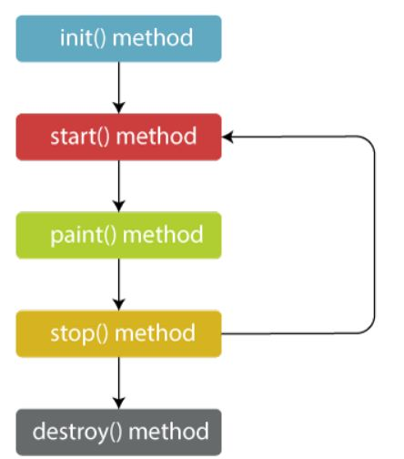
Methods Applet
Flow of Applet Life Cycle:
These methods are invoked by the browser automatically. There is no need to call them explicitly.
.

Slide 14
Methods Applet
Syntax of entire Applet Life Cycle in Java
class TestAppletLifeCycle extends Applet
{
public void init() {
// initialized objects
}
public void start() {
// code to start the applet
}
public void paint(Graphics graphics) {
// draw the shapes
}
public void stop() {
// code to stop the applet
}
public void destroy() {
// code to destroy the applet
}
}

Slide 15
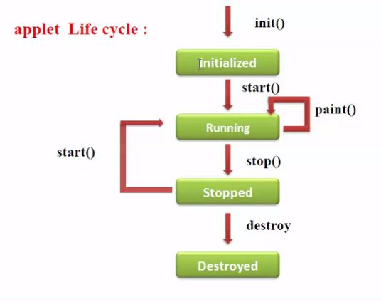
Applets

Slide 16
Advantage of Applet
Advantage of Applet
There are many advantages of applet. They are as follows:
It works at client side so less response time.
Secured
It can be executed by browsers running under many platforms, including Linux, Windows, Mac Os etc.
Drawback of Applet
Plugin is required at client browser to execute applet.

Slide 17
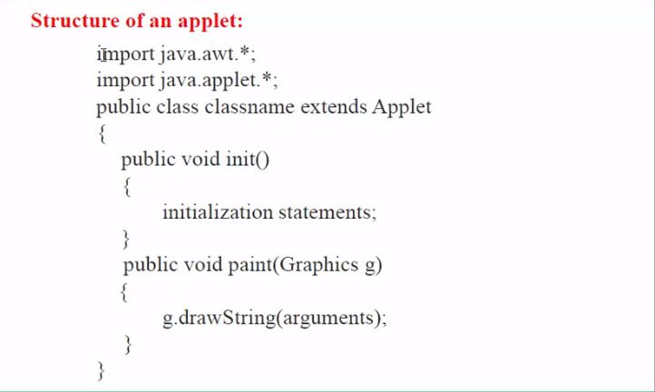
Applets

Slide 18
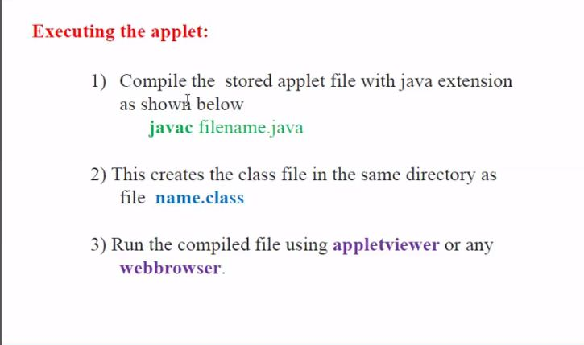
Applets

Slide 19
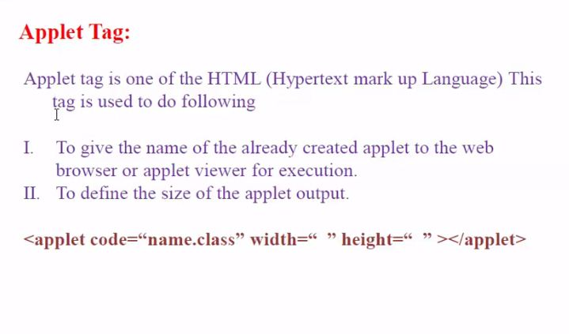
Applets

Slide 20
Example Applets
Simple example of Applet by applet viewer tool:
To execute the applet by applet viewer tool, create an applet that contains applet tag in comment and compile it. After that run it by: applet viewer First.java. Now Html file is not required but it is for testing purpose only.
/First.java
import java.applet.Applet;
import java.awt.Graphics;
public class First extends Applet{
public void paint(Graphics g){
g.drawString("welcome to applet",150,150);
}
}
/*
<applet code="First.class" width="300" height="300">
</applet>
*/
To execute the applet by appletviewer tool, write in command prompt:
c:\>javac First.java c:\>appletviewer First.java

Slide 21
Parameter in Applet
We can get any information from the HTML file as a parameter. For this purpose, Applet class provides a method named getParameter(). Syntax:
public String getParameter (String parameterName)
Example of using parameter in Applet:
import java.applet.Applet;
import java.awt.Graphics;
public class UseParam extends Applet
{
public void paint(Graphics g)
{
String str=getParameter("msg");
g.drawString(str,50, 50);
}
}

Slide 22
Parameter in Applet
myapplet.html
<html>
<body>
<applet code="UseParam.class" width="300" height="300">
<param name="msg" value="Welcome to applet">
</applet>
</body>
</html>

Slide 23
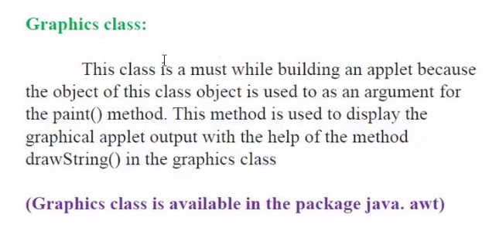
Applets

Slide 24
Displaying Graphics in Applet
java.awt.Graphics class provides many methods for graphics programming.
Commonly used methods of Graphics class:
public abstract void drawString(String str, int x, int y): is used to draw the specified string.
public void drawRect(int x, int y, int width, int height): draws a rectangle with the specified width and height.
public abstract void fillRect(int x, int y, int width, int height): is used to fill rectangle with the default color and specified width and height.
public abstract void drawOval(int x, int y, int width, int height): is used to draw oval with the specified width and height.
public abstract void fillOval(int x, int y, int width, int height): is used to fill oval with the default color and specified width and height.
public abstract void drawLine(int x1, int y1, int x2, int y2): is used to draw line between the points(x1, y1) and (x2, y2).

Slide 25
Displaying Graphics in Applet
public abstract boolean drawImage(Image img, int x, int y, ImageObserver observer): is used draw the specified image.
public abstract void drawArc(int x, int y, int width, int height, int startAngle, int arcAngle): is used draw a circular or elliptical arc.
public abstract void fillArc(int x, int y, int width, int height, int startAngle, int arcAngle): is used to fill a circular or elliptical arc.
public abstract void setColor(Color c): is used to set the graphics current color to the specified color.
public abstract void setFont(Font font): is used to set the graphics current font to the specified font.

Slide 26
Displaying Graphics in Applet
Example of Graphics in applet:
import java.applet.Applet;
import java.awt.*;
public class GraphicsDemo extends Applet
{
public void paint(Graphics g)
{
g.setColor(Color.red);
g.drawString("Welcome",50, 50);
g.drawLine(20,30,20,300);
g.drawRect(70,100,30,30);
g.fillRect(170,100,30,30);
g.drawOval(70,200,30,30);
g.setColor(Color.pink);
g.fillOval(170,200,30,30);
g.drawArc(90,150,30,30,30,270);
g.fillArc(270,150,30,30,0,180);
}
}

Slide 27
Displaying Graphics in Applet
myapplet.html
<html>
<body>
<applet code="GraphicsDemo.class" width="300" height="300">
</applet>
</body>
</html>

Slide 28
Event Handling in Applet
As we perform event handling in AWT or Swing, we can perform it in applet also. Let's see the simple example of event handling in applet that prints a message by click on the button.Example of EventHandling in applet:
import java.applet.*;
import java.awt.*;
import java.awt.event.*;
public class EventApplet extends Applet implements ActionListener{
Button b;
TextField tf;
public void init()
{
tf=new TextField();
tf.setBounds(30,40,150,20);
b=new Button("Click");
b.setBounds(80,150,60,50);

Slide 29
Event Handling in Applet
add(b);add(tf);
b.addActionListener(this);
setLayout(null);
}
public void actionPerformed(ActionEvent e){
tf.setText("Welcome");
}
}
myapplet.html
<html>
<body>
<applet code="EventApplet.class" width="300" height="300">
</applet>
</body>
</html>

Slide 30
GUI Applications
GUI: Graphical User Interface
GUI stands for Graphical User Interface. It refers to an interface that allows one to interact with electronic devices like computers and tablets through graphic elements.
It uses icons, menus and other graphical representations to display information, as opposed to text-based commands.
The graphic elements enable users to give commands to the computer and select functions by using mouse or other input devices.

Slide 31

The programs which run under a GUI has a specific set of graphic elements so that after learning a specific interface, a user can use these programs without learning new commands.
Xerox 8010 Information system was the first GUI-centric computer operating model. It was developed at Xerox PARC by Alan Kay, Douglas Engelbart and their associates.
As of 2014, the most popular GUIs are Microsoft Windows and Mac OS X. And, if we talk about mobile devices, the Apple's IOS and Google's Android Interface are the widely used GUIs.

Slide 32
Basic Components of a GUI
Pointer: It is a symbol that appears on the display screen. It can be moved to select commands and objects.
Pointing device: It allows you move the pointer and select objects on the screen, e.g. mouse or trackball.
Icons: It refers to small images on the display screen that represent commands, files, windows etc.
Using pointer and pointing device, you can execute these commands.
Desktop: It is the display screen that contains the icons.

Slide 33
GUI KEY Benefits
It allows you to place more information within a program.
The graphics allow users to use complex programs with greater ease.
It saves time as you do not need to edit configurations manually.
You can easily memorize the tasks (point-and-click).
Helps create user-friendly software with a point-and-click interface.

Slide 34
AWT Classes
The AWT classes are contained in the java.awt package. It is one of Java’s largest packages. Fortunately,
because it is logically organized in a top-down, hierarchical fashion, it is easier to understand and use than you might at first believe.

Slide 35
AWT CLASSES
The AWTclasses are contained in the java. ...
AWTEvent : Encapsulates AWTevents.
AWTEventMulticaster : Dispatches events to multiple listeners.
BorderLayout : The border layout manager. ...
Button : Creates a push button control.
Canvas : A blank, semantics-free window.
CardLayout : The card layout manager.

Slide 36
WINDOW FUNDAMENTALS
Java Abstract window tool kit package is used for displaying the data within a GUI Environment.
Features of AW T Package are as Followings:
1. It provides us a set of user interface components including windows buttons text fields scrolling list etc.
2. It provides us the way to laying out these above components.
3. It provides to create the events upon these components.
The main purpose for using the AWT is using for all the components displaying on the screen.
Awt defines all the windows according to a class hierarchy those are useful at a specific level or we can say arranged according to their functionality.

Slide 37
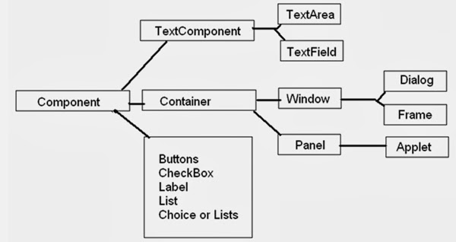

Slide 38
Creating Window
A graphical user interface starts with a top-level container which provides a home for the
other components of the interface, and dictates the overall feel of the application.
In this tutorial, we introduce the JFrame class, which is used to create a simple top-level window for a Java application.

Slide 39
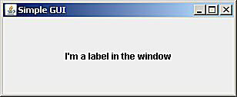
Import the Graphical Components
Microsoft product screen shot(s) reprinted with permission from Microsoft Corporation

Slide 40
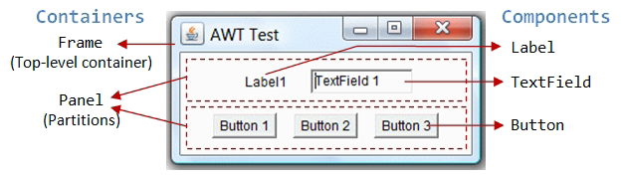
Containers and Components
There are two types of GUI elements:
1. Component: Components are elementary GUI entities, such as Button, Label, and TextField.
2. Container: Containers, such as Frame and Panel, are used to hold components in a specific layout (such as FlowLayout or GridLayout). A container can also hold sub-containers.

Slide 41
Create a Message Dialog Box
Dialog class is used to create a top-level container Dialog window which contains a set of components
There are two kinds of Dialog windows -
Modal Dialog window
When a modal dialog window is active, all the user inputs are directed to it and all the other parts of application are inaccessible until this model dialog is closed.
Modeless Dialog window
When a modeless dialog window is active, the other parts of application are still accessible as normal and inputs can be directed to them, without needing to close this modeless dialog window.

Slide 42
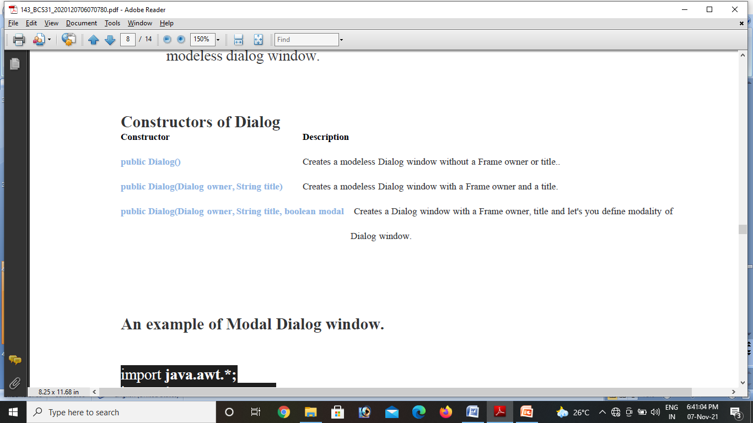

Slide 43
An example of Modal Dialog window.
import java.awt.*;
import java.awt.event.*;
public class DialogEx2 extends WindowAdapter implements ActionListener
{
Frame frame;
Label label1;
TextField field1;
Button button1, button2, button3;
Dialog d1, d2, d3;
DialogEx2()
{
frame = new Frame("Frame");
button1 = new Button("Open Modal Dialog");
label1 = new Label("Click on the button to open a Modal Dialog");
frame.add(label1);
frame.add(button1);
button1.addActionListener(this);
frame.pack();

Slide 44
frame.setSize(330,250);
frame.setVisible(true);
}
public void actionPerformed(ActionEvent ae)
{
if(ae.getActionCommand().equals("Open Modal Dialog"))
{
//Creating a non-modeless blocking Dialog
d1= new Dialog(frame,"Modal Dialog",true);
Label label= new Label("You must close this dialog window to use Frame
window",Label.CENTER);
d1.add(label);
d1.addWindowListener(this);
d1.pack();
d1.setLocationRelativeTo(frame);
d1.setLocation(new Point(100,100));
d1.setSize(400,200);
d1.setVisible(true);
}}
public void windowClosing(WindowEvent we)
{
d1.setVisible(false);
}
public static void main(String...ar)
{
new DialogEx2();
}
}

Slide 45
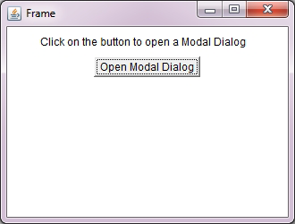
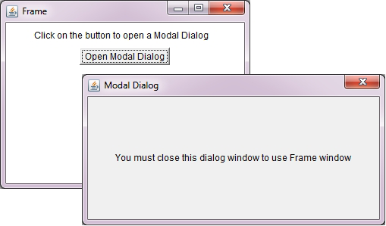
O/P

Slide 46
Example of Border Layout class:
import java.awt.*;
2. import javax.swing.*;
3.
4. public class Border {
5. JFrame f;
6. Border(){
7. f=new JFrame();
8. JButton b1= new JButton("NORTH");;
9. JButton b2= new JButton("SOUTH");;
10. JButton b3= new JButton("EAST");;
11. JButton b4= new JButton("WEST");;
12. JButton b5= new JButton("CENTER");;
13. f.add(b1,BorderLayout.NORTH);
14. f.add(b2,BorderLayout.SOUTH);
15. f.add(b3,BorderLayout.EAST);
16. f.add(b4,BorderLayout.WEST);
17. f.add(b5,BorderLayout.CENTER);
18. f.setSize(300,300);
19. f.setVisible(true);
20. }
21. public static void main(String[] args) {
22. new Border();
23. }
24. }

Slide 47
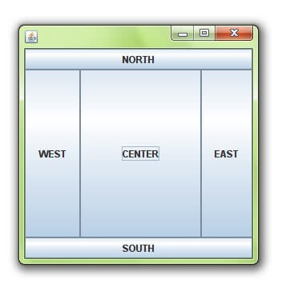

Slide 48
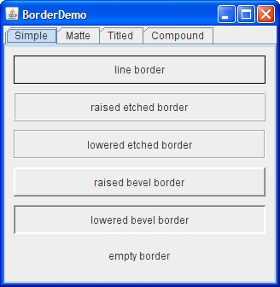
The Border Demo Example

Slide 49
Java Layout Managers
1. java.awt.BorderLayout
2. java.awt.FlowLayout
3. java.awt.GridLayout
4. java.awt.CardLayout
5. java.awt.GridBagLayout
6. javax.swing.BoxLayout
7. javax.swing.GroupLayout
8. javax.swing.ScrollPaneLayout
9. javax.swing.SpringLayout etc.

Slide 50
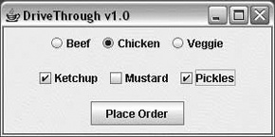
Java Border Layout
1.public static final int NORTH
2. public static final int SOUTH
3. public static final int EAST
4. public static final int WEST
5. public static final int CENTER
6. Checkboxes and Radio Buttons

Slide 51
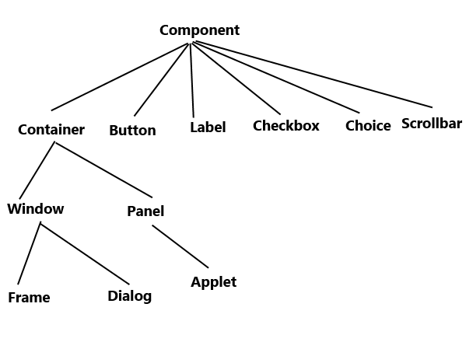
AWT component classes

Slide 52
Window: An instance of the Window class has no border and no title Dialog: Dialog class has border and title. An instance of the Dialog class cannot exist without an associated instance of the Frame class. Panel: Panel does not contain title bar, menu bar or border. It is a generic container for holding components. An instance of the Panel class provides a container to which to add components. Frame: A frame has title, border and menu bars. It can contain several components like buttons, text fields, scrollbars etc. This is most widely used container while developing an application in AWT.

Slide 53
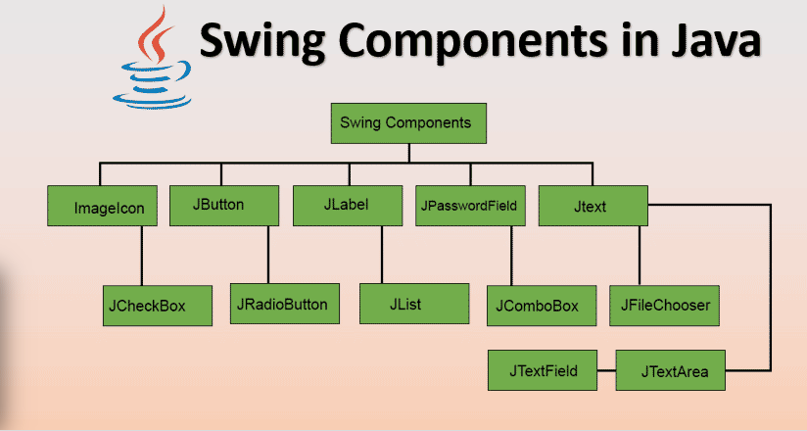
Swing component classes
https://www.educba.com/swing-components-in-java/ /

Slide 54
Top 13 Components of Swing in Java
1. ImageIcon
The ImageIcon component creates an icon sized-image from an image residing at the source URL.
Example:
ImageIcon homeIcon = new ImageIcon(“src/images/home.jpg”);
This returns an icon of a home button.
The string parameter is the path at which the source image is present.

Slide 55
2. JButton
JButton class is used to create a push-button on the UI. The button can contain some display text or image.
It generates an event when clicked and double-clicked.
A JButton can be implemented in the application by calling one of its constructors.
Example:
JButton okBtn = new JButton(“Ok”);

